Slide 1


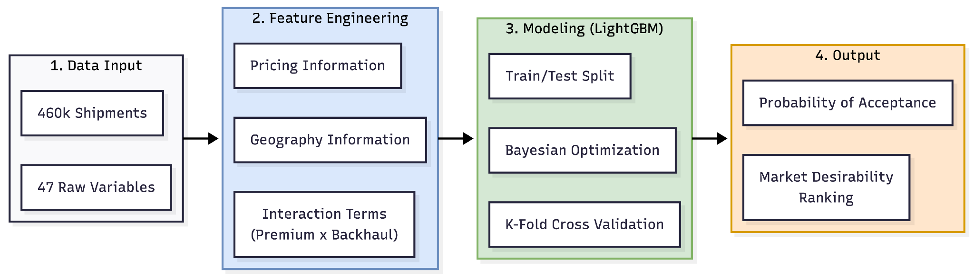
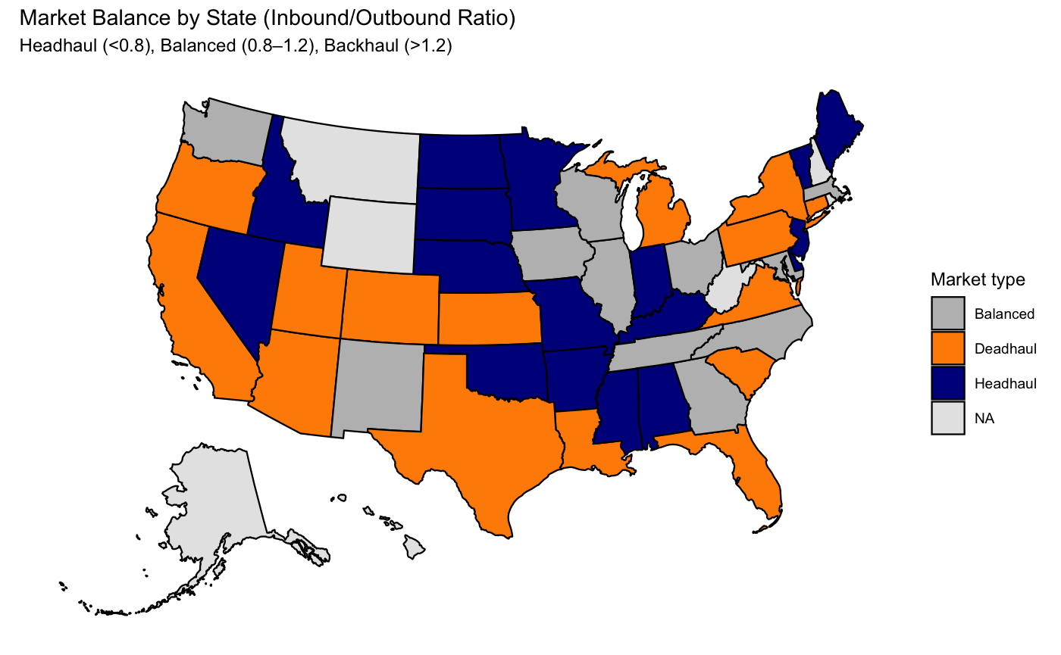
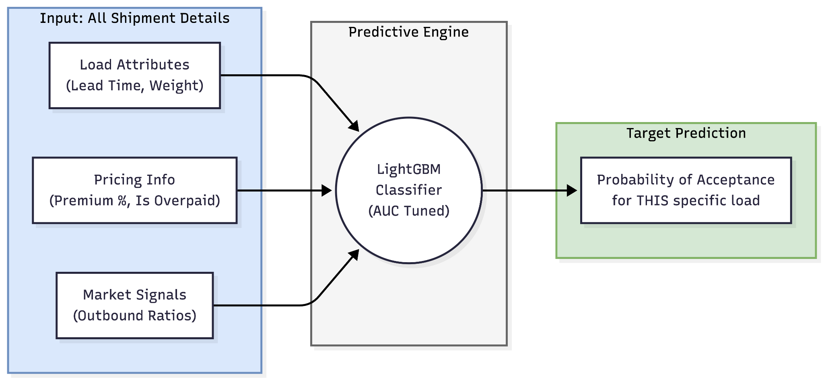

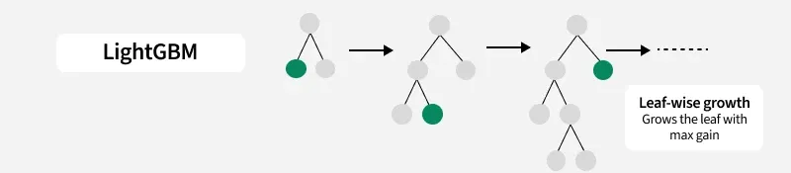
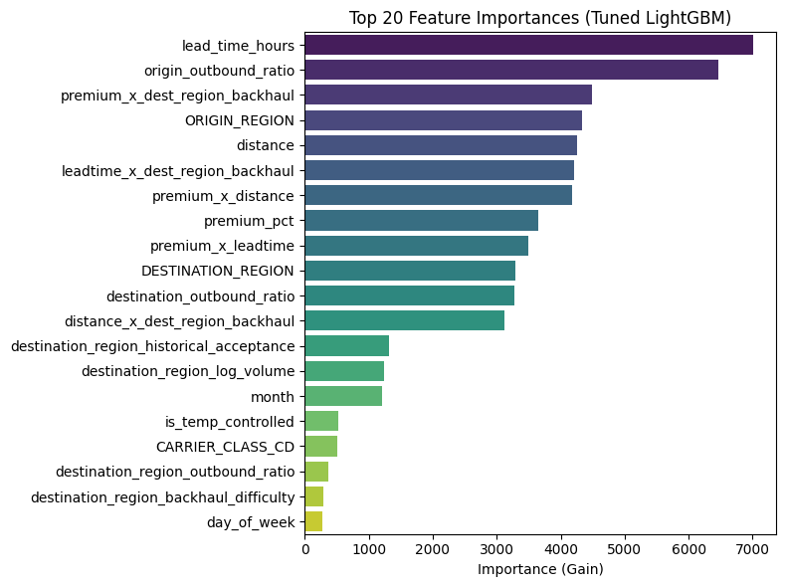
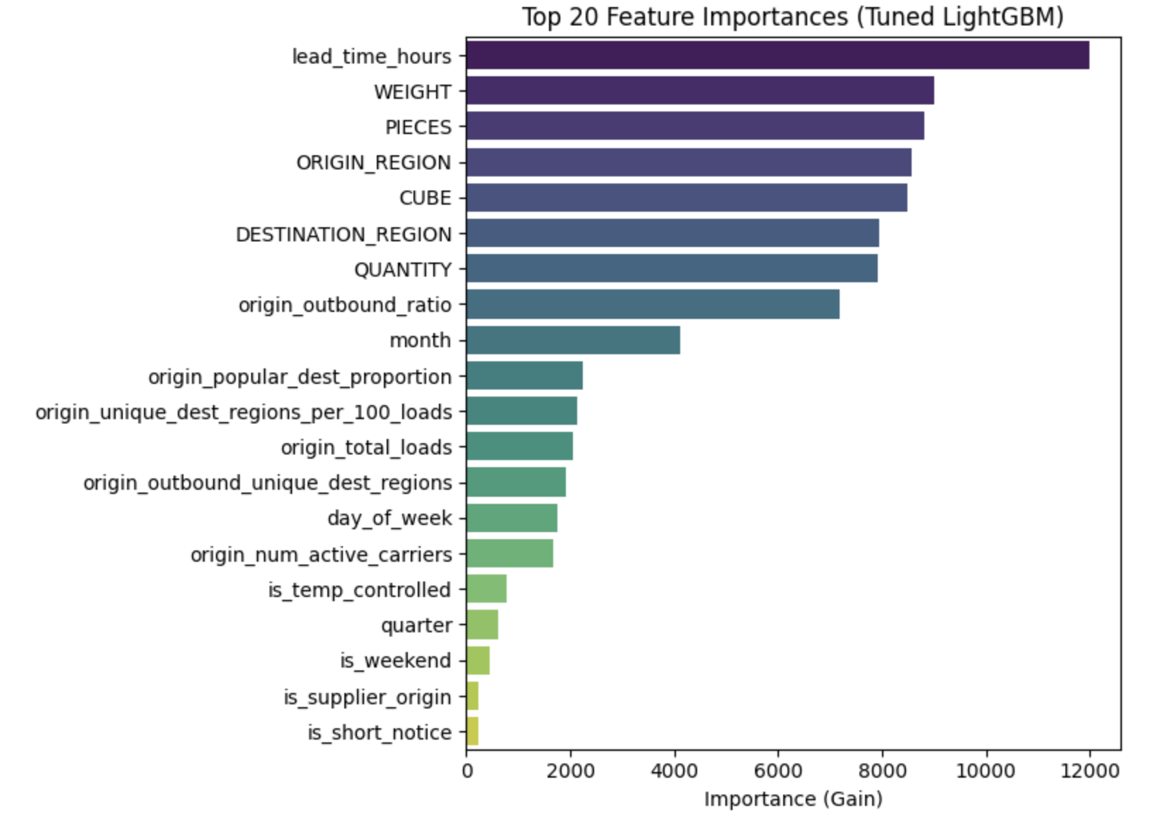
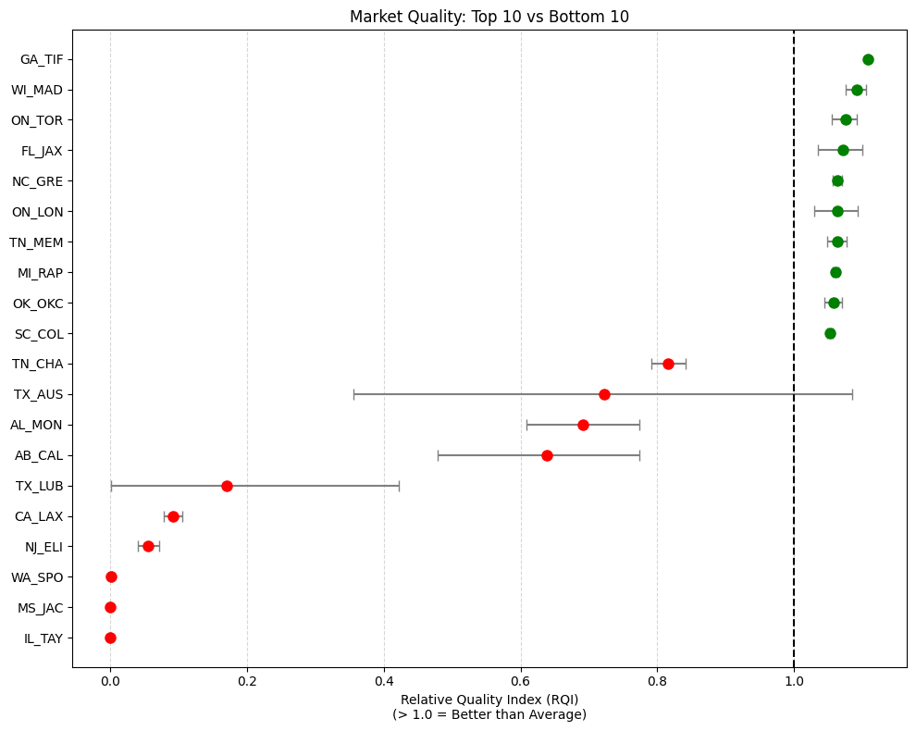
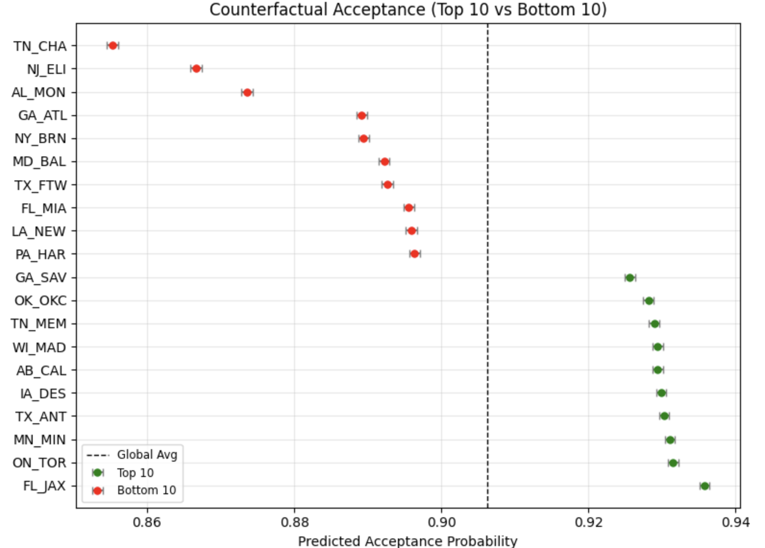
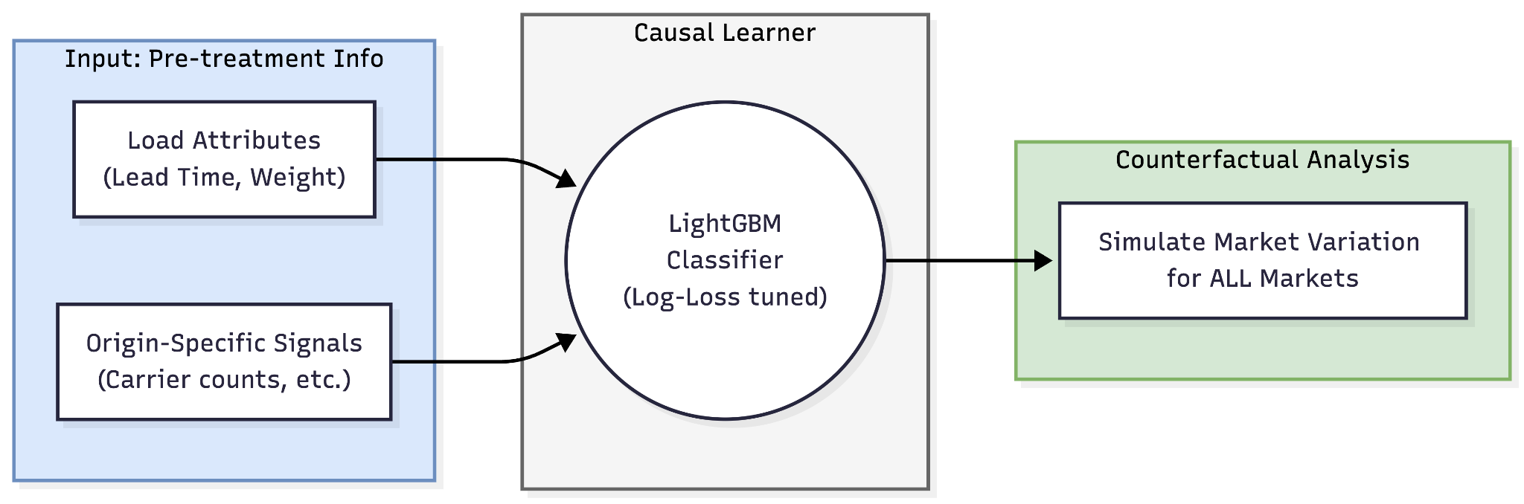
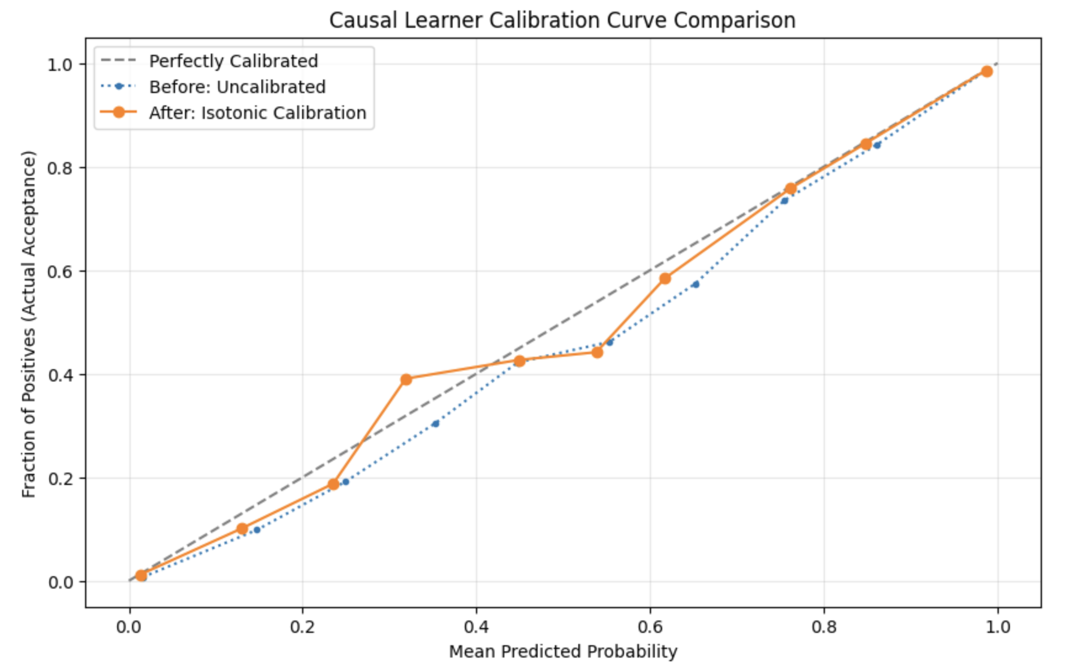
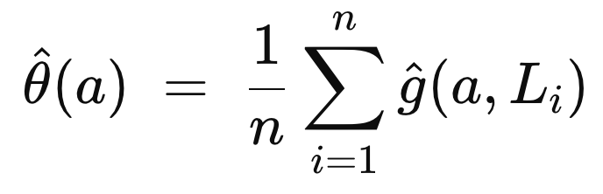
Ranking Market Desirability
For Armada Carriers
By Aidan McIndoe, Michael Zheng, Yuhao Ren
Research Advisor: Gonzalo Mena
Introduction
Methods
Armada Supply Chain Solutions is a national Logistics Company which operates a network of carriers across the United States. Armada coordinates with both internal and external carriers in order to ensure that truck loads reach their intended destination in a timely manner.
However, not all markets are created equal. Although Armada has to service certain markets regardless of volume, carriers have individual preferences for different markets. Carriers are also semi-autonomous, and can decline truck loads for various reasons. Our project sought to determine which markets were most desirable to carriers, and then provide a ranking of the most desirable markets.
Predictive Pipeline
Results
Predictive Model
Causal Inference Model
 | Predicted Negative | Predicted Positive
Actual Negative | 6437 | 594
Actual Positive | 595 | 69113
Best Model Test Log Loss: | 0.0986
Causal Pipeline
Conclusion
The Key Takeaways: The following markets are ranked among the top 10 markets when using both approaches. These are: Jacksonville (FL), Toronto (ON), Madison (WI), Memphis (TN), and Oklahoma (OK). This suggests that these markets are the most desirable markets to Armada carriers. Load lead time and the origin city’s inbound/outbound ratio appeared to significantly influence market desirability. Operational wise, these appear to be more important than pricing for carriers.
Future Research:
Human verification of model results
Armada is more familiar with their network than we are, able to identify predictions that seem “off”
More detailed analysis of market desirability by more groupings
Include other data which might not have been available in this data set
The causal analysis pipeline can be easily adjusted, allowing it to investigate other variables of interest

